Slide 1
Multivariable Control

Slide 2
Quadruple Tank
MATLAB & SIMULINK

Slide 3
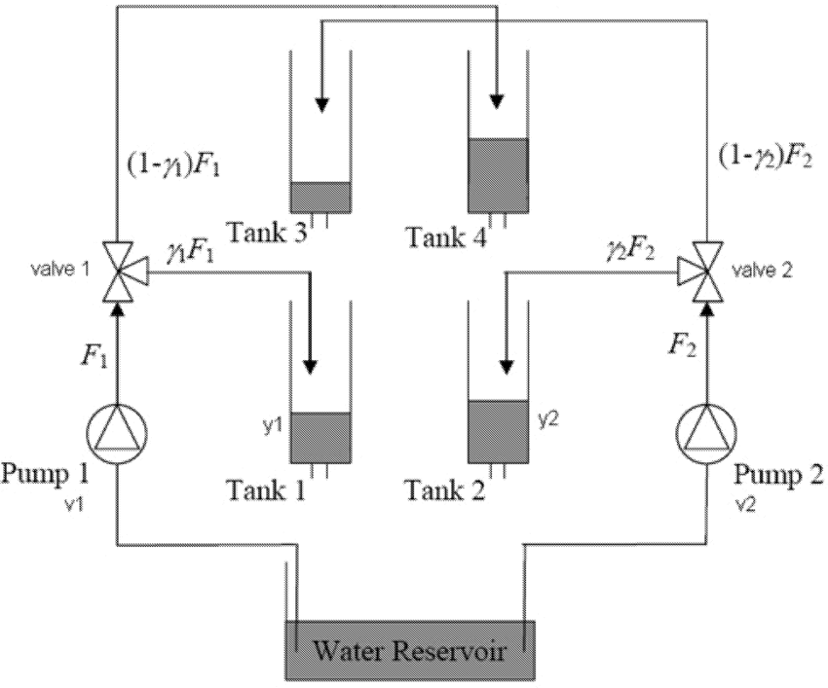
Quadruple Tank problem
LC
LT
LT
LC

Slide 4
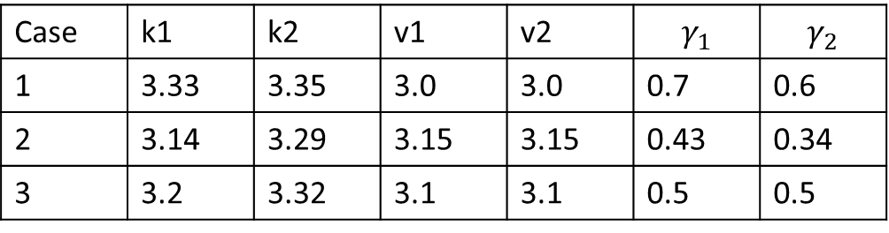
Quadruple Tank problem
Control Objective
Both the levels of tank1 and tank2 should be controlled by manipulating voltages to the pumps.
Data for simulation:
A₁, A₃ = 28 cm²
A₂, A₄ = 32 cm²
a₁, a₃ = 0.071 cm²
a₂, a₄ = 0.057 cm²
Case | k1 | k2 | v1 | v2 | $$γ_{1}$$ | $$γ_{2}$$
1 | 3.33 | 3.35 | 3.0 | 3.0 | 0.7 | 0.6
2 | 3.14 | 3.29 | 3.15 | 3.15 | 0.43 | 0.34
3 | 3.2 | 3.32 | 3.1 | 3.1 | 0.5 | 0.5

Slide 5
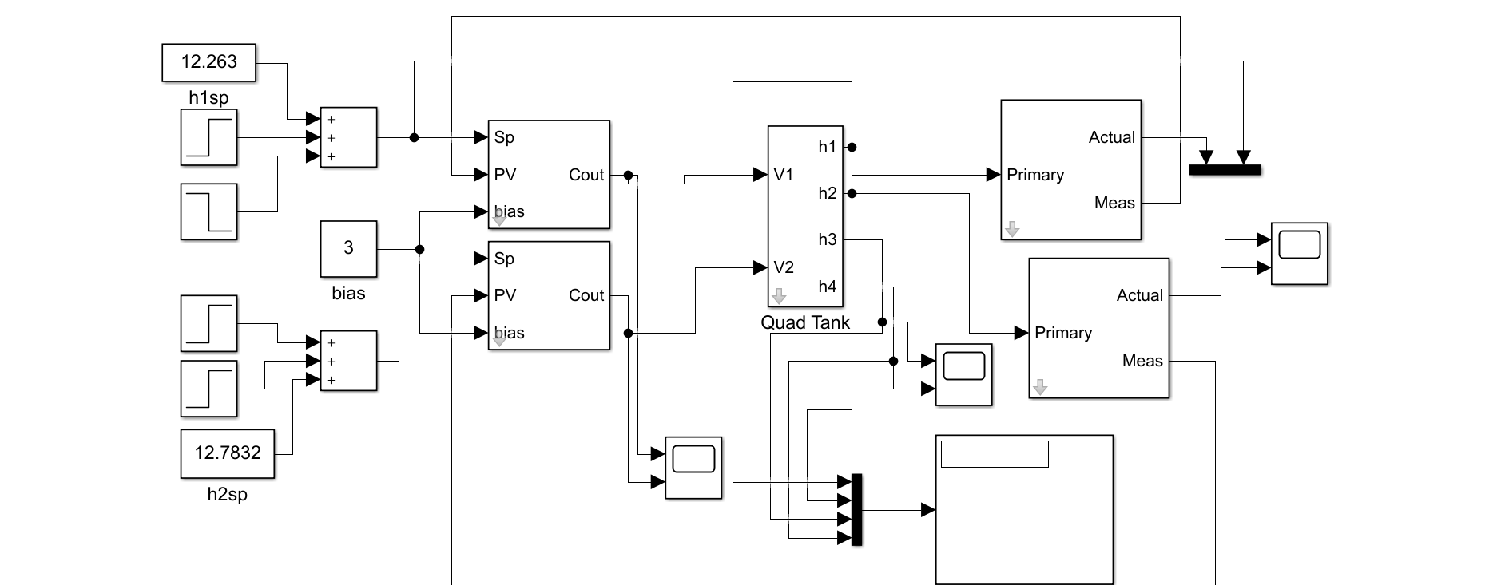
Simulink Model of Quad Tank
Let simulate the Model in Simulink

Slide 6
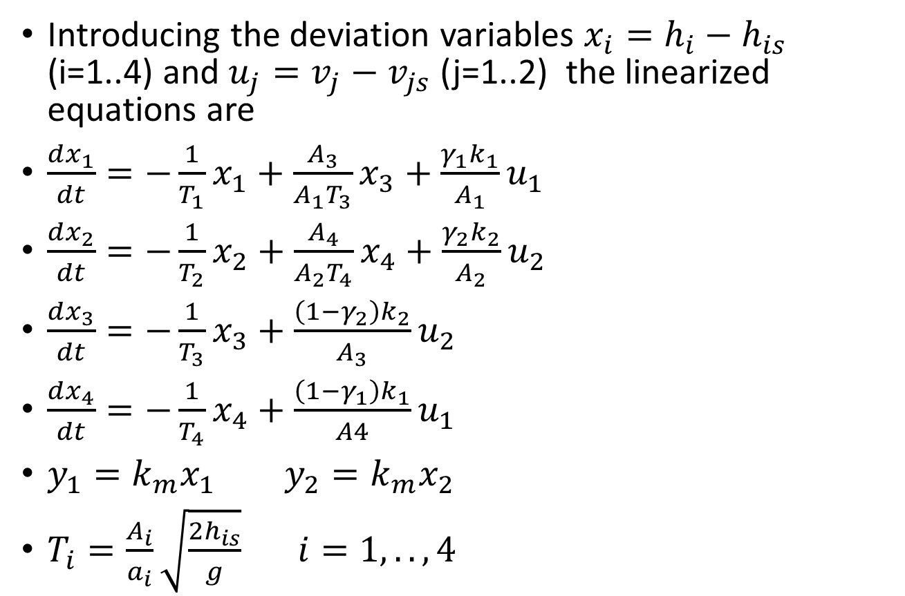
Linearized Equations for Quad Tank
Introducing the deviation variables $x_{i}=h_{i}−h_{is}$ (i=1..4) and $u_{j}=v_{j}−v_{js}$ (j=1..2) the linearized equations are
$\frac{dx_{1}}{dt}=−\frac{1}{T_{1}}x_{1}+\frac{A_{3}}{A_{1}T_{3}}x_{3}+\frac{γ_{1}k_{1}}{A_{1}}u_{1}$
$\frac{dx_{2}}{dt}=−\frac{1}{T_{2}}x_{2}+\frac{A_{4}}{A_{2}T_{4}}x_{4}+\frac{γ_{2}k_{2}}{A_{2}}u_{2}$
$\frac{dx_{3}}{dt}=−\frac{1}{T_{3}}x_{3}+\frac{\left(1−γ_{2}\right)k_{2}}{A_{3}}u_{2}$
$\frac{dx_{4}}{dt}=−\frac{1}{T_{4}}x_{4}+\frac{\left(1−γ_{1}\right)k_{1}}{A4}u_{1}$
$y_{1}=k_{m}x_{1}$ $y_{2}=k_{m}x_{2}$
$T_{i}=\frac{A_{i}}{a_{i}}\sqrt{\frac{2h_{is}}{g}} i=1,..,4$

Slide 7
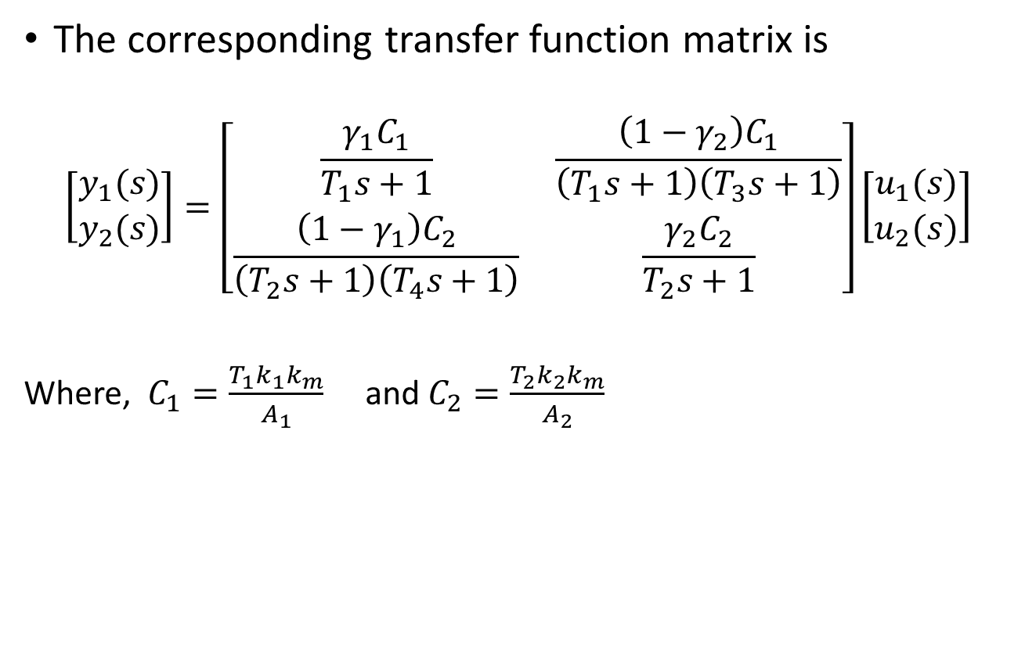
Transfer function matrix of Quad Tank
The corresponding transfer function matrix is
$$\left[\begin{matrix}y_{1}(s) \\ y_{2}(s)\end{matrix}\right]=\left[\begin{matrix}\frac{γ_{1}C_{1}}{T_{1}s+1} & \frac{\left(1−γ_{2}\right)C_{1}}{\left(T_{1}s+1\right)\left(T_{3}s+1\right)} \\ \frac{\left(1−γ_{1}\right)C_{2}}{\left(T_{2}s+1\right)\left(T_{4}s+1\right)} & \frac{γ_{2}C_{2}}{T_{2}s+1}\end{matrix}\right]\left[\begin{matrix}u_{1}(s) \\ u_{2}(s)\end{matrix}\right]$$
Where, $C_{1}=\frac{T_{1}k_{1}k_{m}}{A_{1}}$ and $C_{2}=\frac{T_{2}k_{2}k_{m}}{A_{2}}$

Slide 8
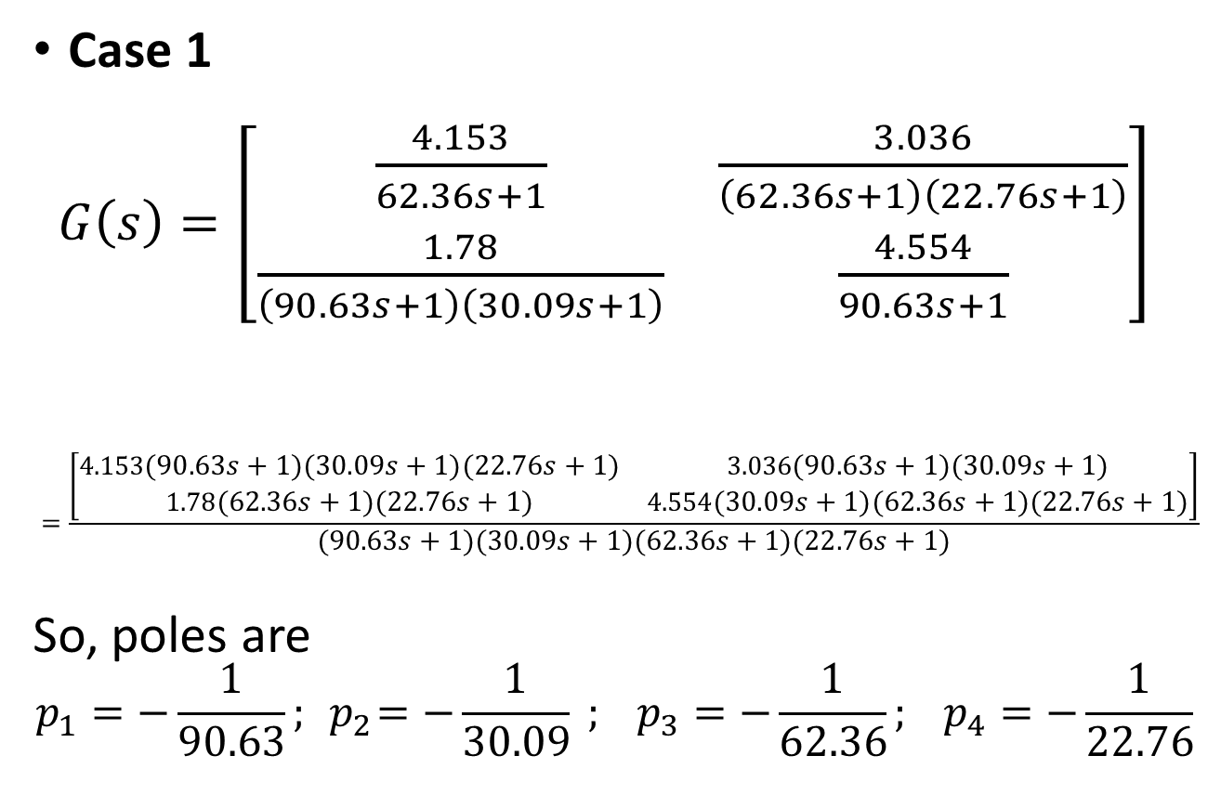
Poles and Zeros of Quad Tank
Case 1
$G\left(s\right)=\left[\begin{matrix}\frac{4.153}{62.36s+1} & \frac{3.036}{\left(62.36s+1\right)\left(22.76s+1\right)} \\ \frac{1.78}{\left(90.63s+1\right)\left(30.09s+1\right)} & \frac{4.554}{90.63s+1}\end{matrix}\right]$
$$=\frac{\left[\begin{matrix}4.153\left(90.63s+1\right)\left(30.09s+1\right)\left(22.76s+1\right) & 3.036\left(90.63s+1\right)\left(30.09s+1\right) \\ 1.78\left(62.36s+1\right)\left(22.76s+1\right) & 4.554\left(30.09s+1\right)\left(62.36s+1\right)\left(22.76s+1\right)\end{matrix}\right]}{\left(90.63s+1\right)\left(30.09s+1\right)\left(62.36s+1\right)\left(22.76s+1\right)}$$
So, poles are
$$p_{1}=−\frac{1}{90.63}; { p}_{2}=−\frac{1}{30.09} ; p_{3}=−\frac{1}{62.36}; p_{4}=−\frac{1}{22.76}$$

Slide 9
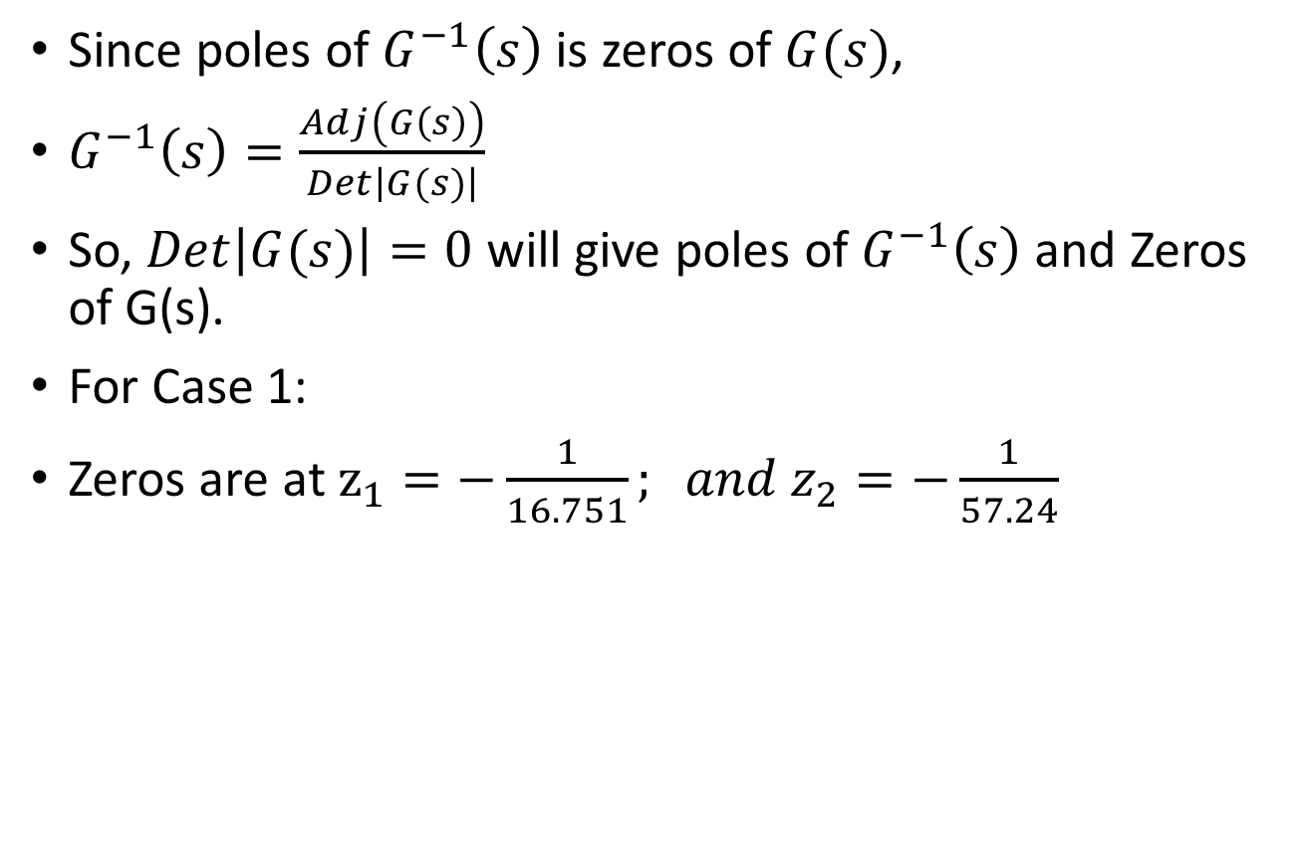
Zeros of the system
Since poles of $G^{−1}\left(s\right)$ is zeros of $G(s)$,
$G^{−1}\left(s\right)=\frac{Adj\left(G\left(s\right)\right)}{Det\left|G(s)\right|}$
So, $Det\left|G(s)\right|=0$ will give poles of $G^{−1}\left(s\right)$ and Zeros of G(s).
For Case 1:
Zeros are at $z_{1}=−\frac{1}{16.751}; and z_{2}=−\frac{1}{57.24}$

Slide 10
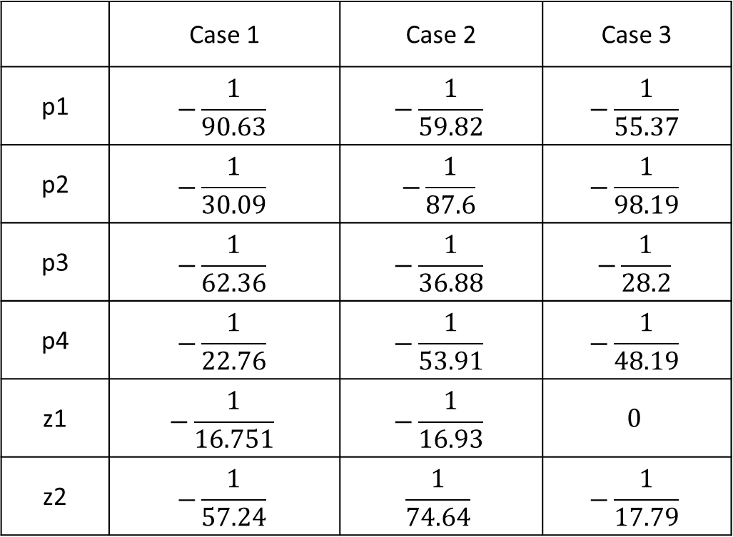
Poles and Zeros of Quad Tank
 | Case 1 | Case 2 | Case 3
p1 | $$−\frac{1}{90.63}$$ | $$−\frac{1}{59.82}$$ | $$−\frac{1}{55.37}$$
p2 | $$−\frac{1}{30.09}$$ | $$−\frac{1}{87.6}$$ | $$−\frac{1}{98.19}$$
p3 | $$−\frac{1}{62.36}$$ | $$−\frac{1}{36.88}$$ | $$−\frac{1}{28.2}$$
p4 | $$−\frac{1}{22.76}$$ | $$−\frac{1}{53.91}$$ | $$−\frac{1}{48.19}$$
z1 | $$−\frac{1}{16.751}$$ | $$−\frac{1}{16.93}$$ | $$0$$
z2 | $$−\frac{1}{57.24}$$ | $$\frac{1}{74.64}$$ | $$−\frac{1}{17.79}$$

Slide 11
Multi-Loop vs Multivariable Control
Multi-loop - use of several single-loop controllers (e.g., PID) on pairs of manipulated/controlled variables
Multivariable - make control adjustments decisions jointly considering all outputs simultaneously
Multi-loop control configurations are typically used as a base control configuration and reside in the Distributed Control System (DCS).
» e.g., flow control, temperature control, pressure control
Multivariable control configurations typically require additional computational capability, and sit over a base multi-loop control configuration, sending setpoints to the multi-loop controllers.

Slide 12
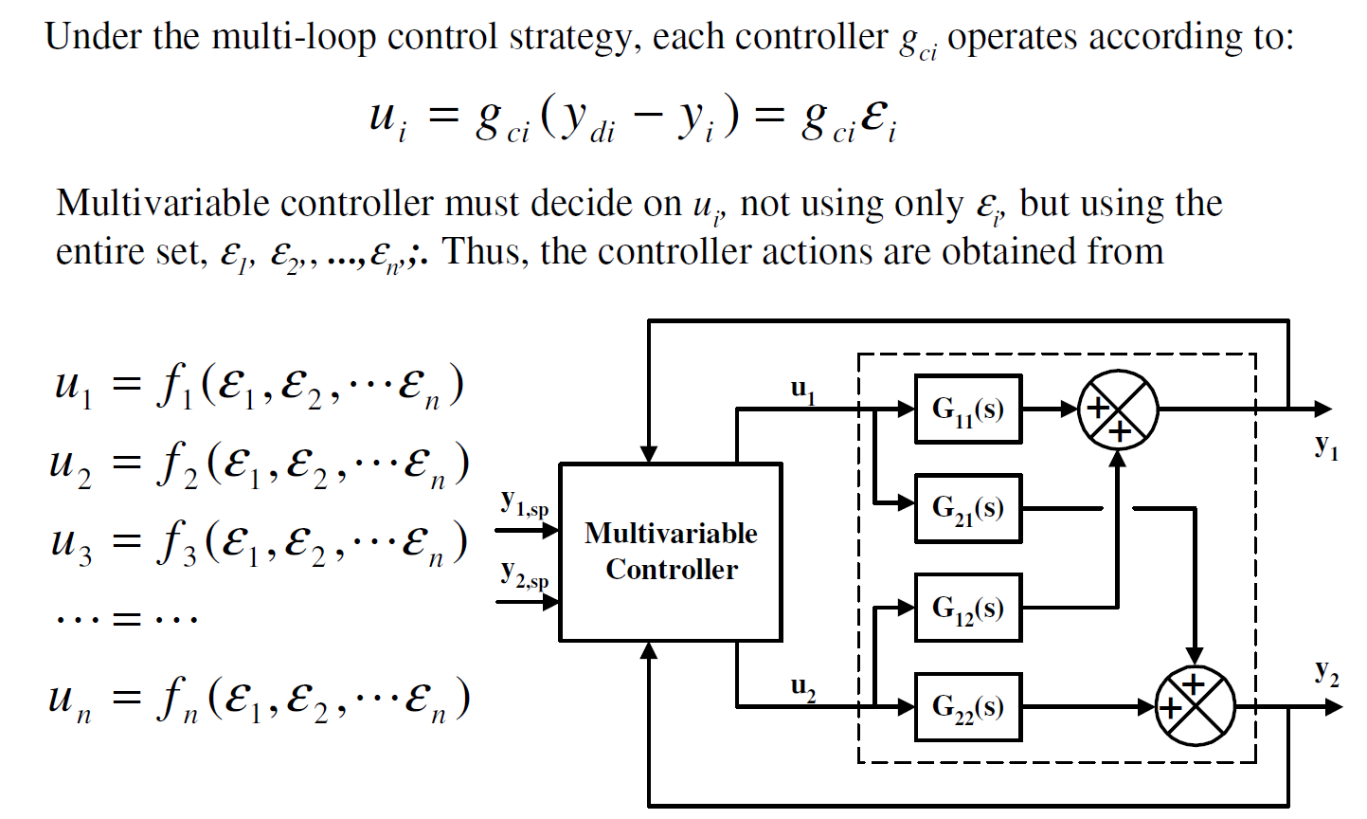
Multi-Loop vs Multivariable Control

